Slide 1
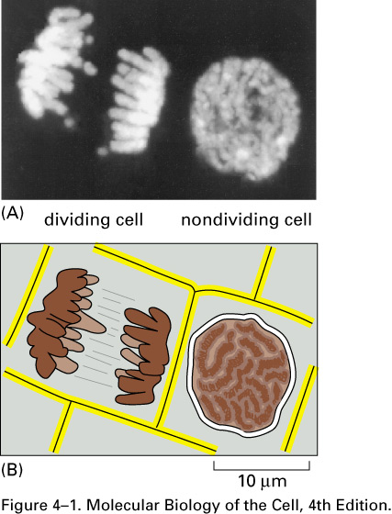
Hereditary information is carried on Chromosomes that consist of both DNA and proteins
Chromosomes in cells.
(A) Two adjacent plant cells photographed through a light microscope. The DNA has been stained with a fluorescent dye (DAPI) that binds to it. The DNA is present in chromosomes, which become visible as distinct structures in the light microscope only when they become compact structures in preparation for cell division, as shown on the left. The cell on the right, which is not dividing, contains identical chromosomes, but they cannot be clearly distinguished in the light microscope at this phase in the cell’s life cycle, because they are in a more extended conformation. (B) Schematic diagram of the outlines of the two cells along with their chromosomes.

Slide 2
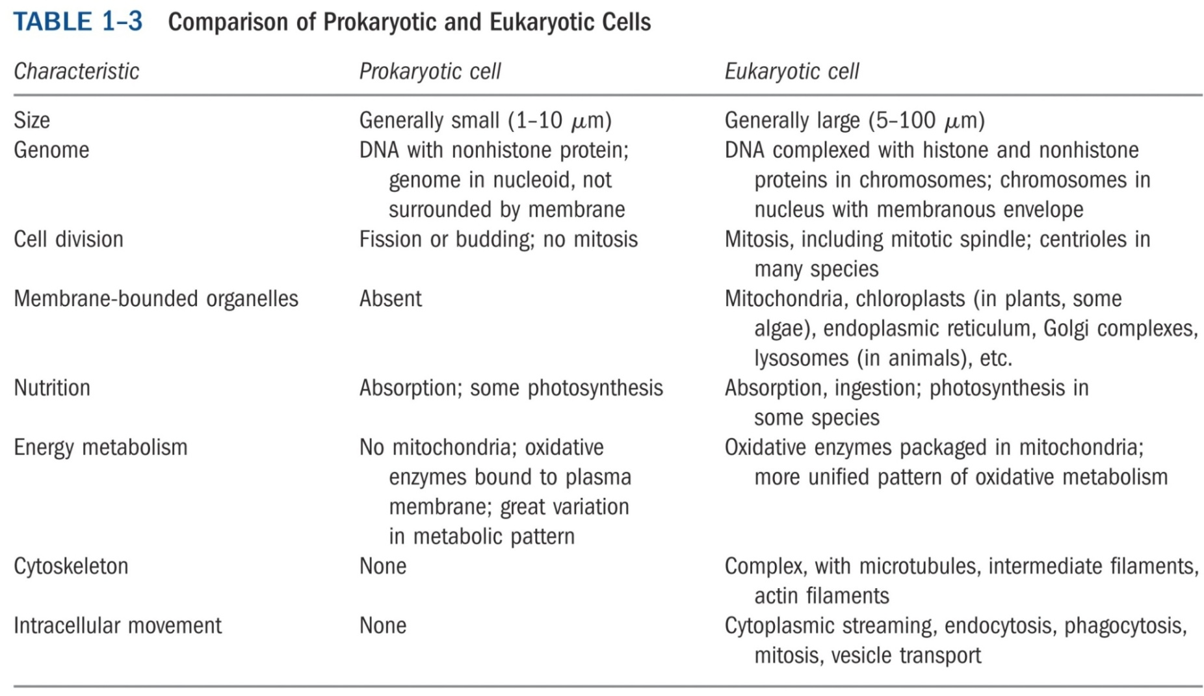
Chromosomal DNA and its packaging in the chromatin fiber
Eucaryotic DNA is enclosed in cell nucleus,
and is packaged into a set of chromosomes

Slide 3
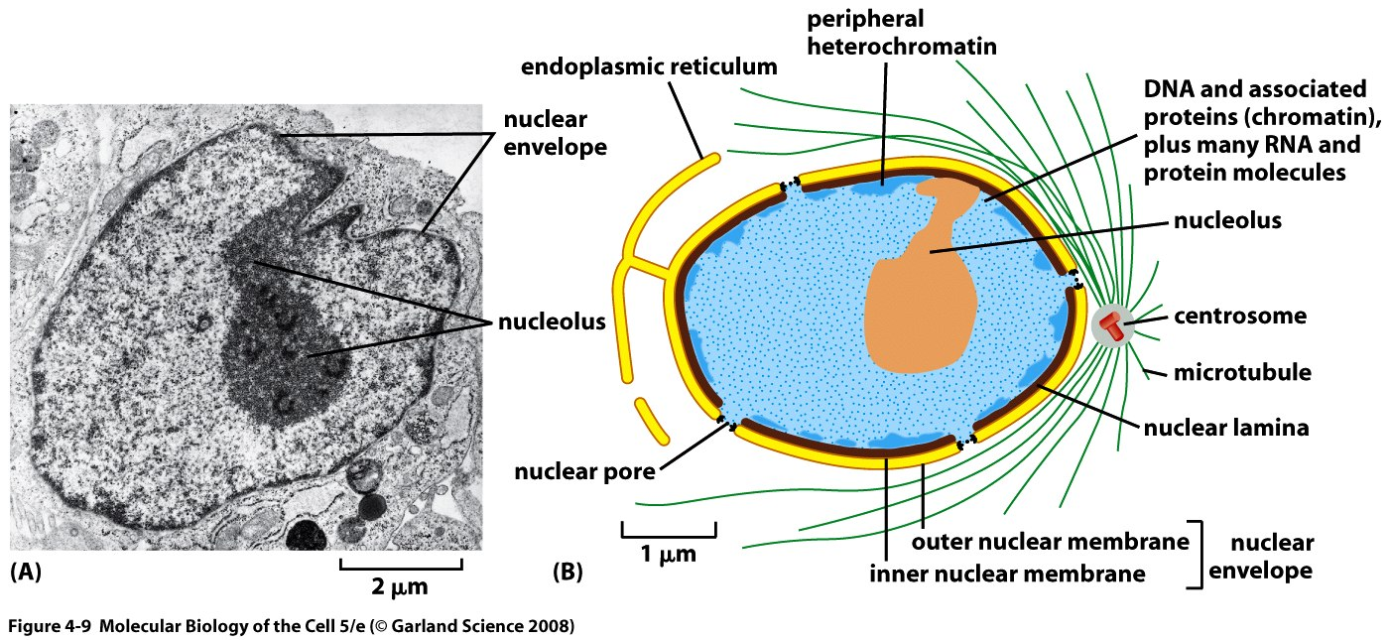
Cell Nucleus

Slide 4
Chromosome Structure
Human DNA’s total length is ~2 meters!
This must be packaged into a nucleus that is about 5 micrometers in diameter
This represents a compression of more than 100,000x
It is made possible by wrapping the DNA around protein spools called nucleosomes and then packing these in helical filaments

Slide 5
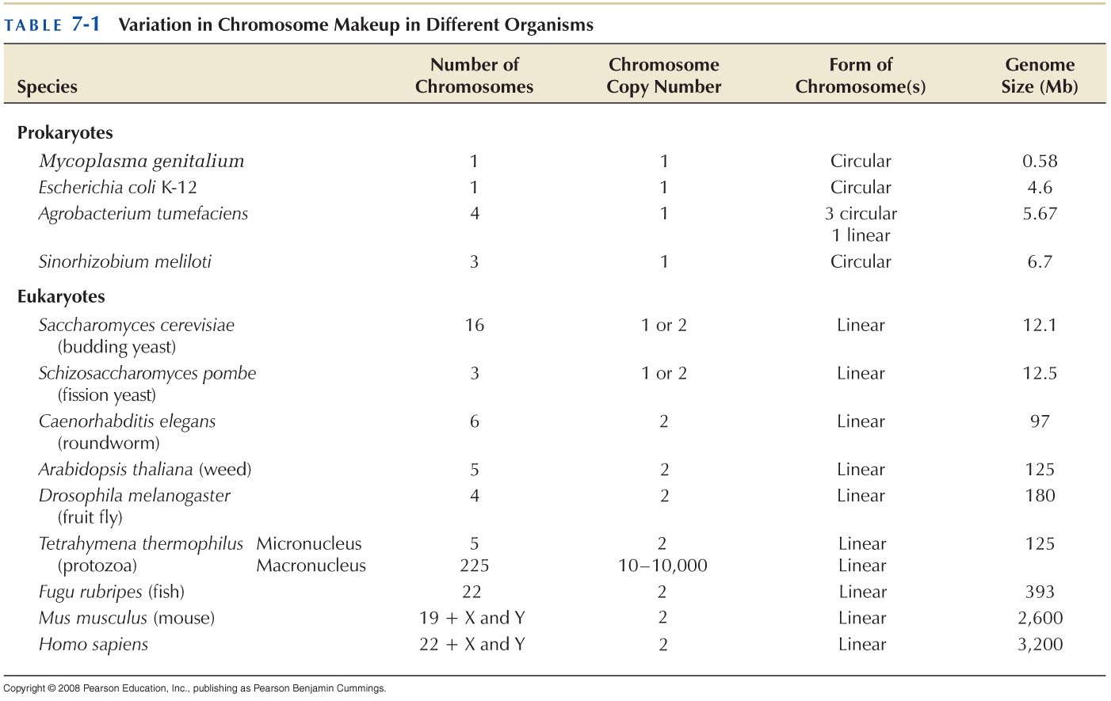
GENOME SEQUENCE AND CHROMOSOME DIVERSITY
Chromosomes can be circular or linear

Slide 6
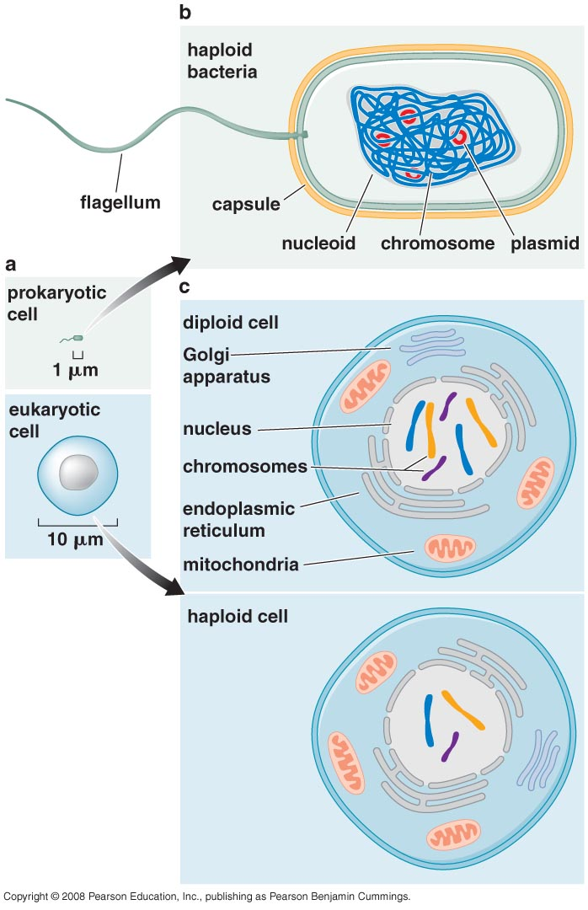
Every cell maintains a characteristic number of chromosomes

Slide 7
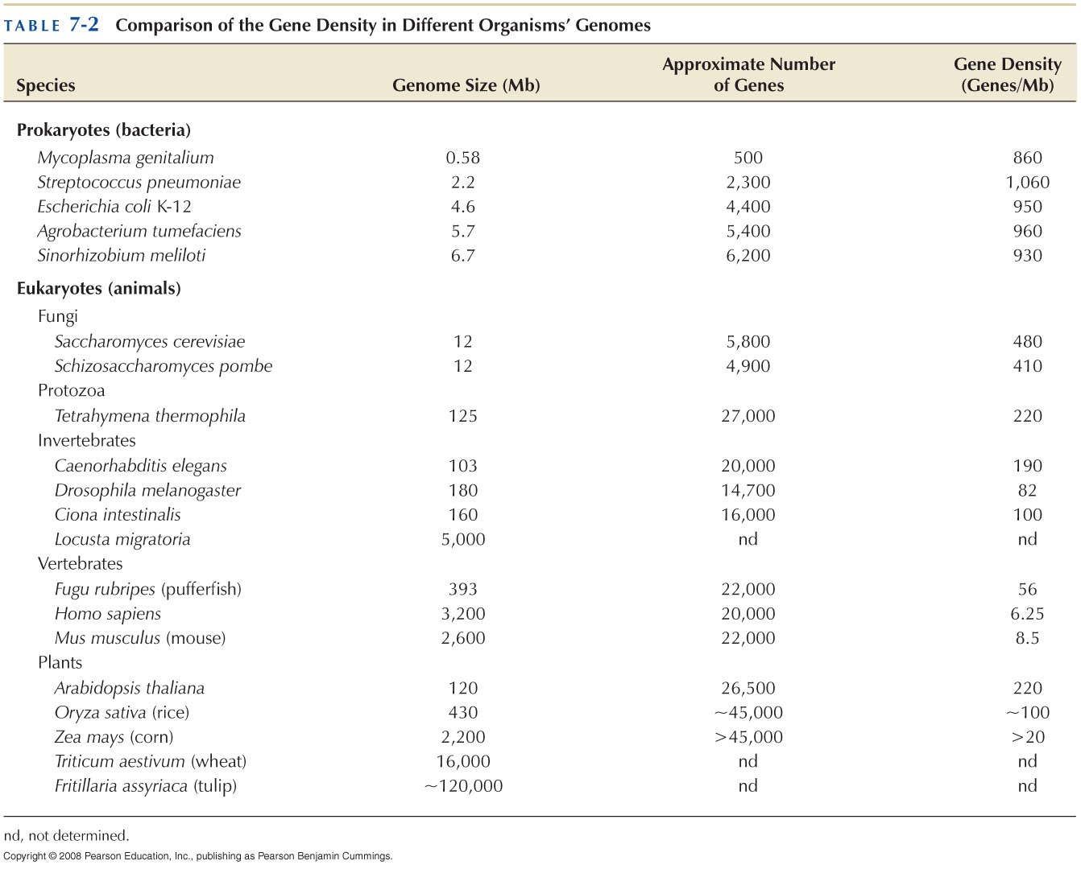
Genome size is related to the complexity of the organism

Slide 8
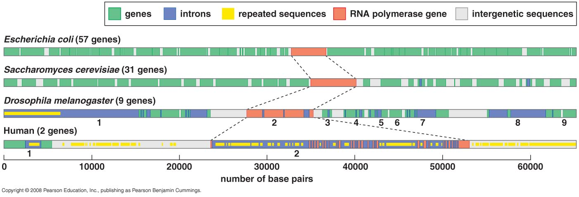
The E. coli genome is composed almost entirely of genes
More complex organisms have decreased gene density

Slide 9
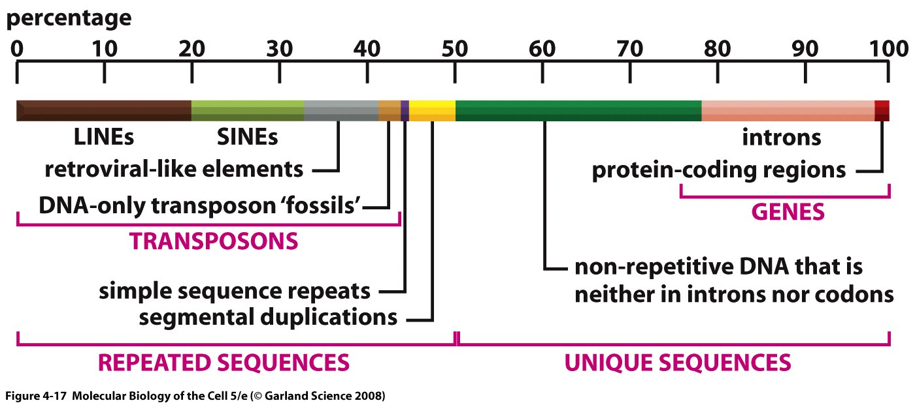
Genes make up only a small portion of the eukaryotic chromosomal DNA
Representation of the nucleotide sequence content of the human genome.
LINES, SINES, retroviral-like elements, and DNA-only transposons are all mobile genetic elements that have multiplied in our genome by replicating themselves and inserting the new copies in different positions. Simple sequence repeats are short nucleotide sequences (less than 14 nucleotide pairs) that are repeated again and again for long stretches. Segmental duplications are large blocks of the genome (1000–200,000 nucleotide pairs) that are present at two or more locations in the genome. Over half of the unique sequence consists of genes and the remainder is probably regulatory DNA. Most of the DNA present in heterochromatin, a specialized type of chromatin that contains relatively few genes, has not yet been sequenced

Slide 10
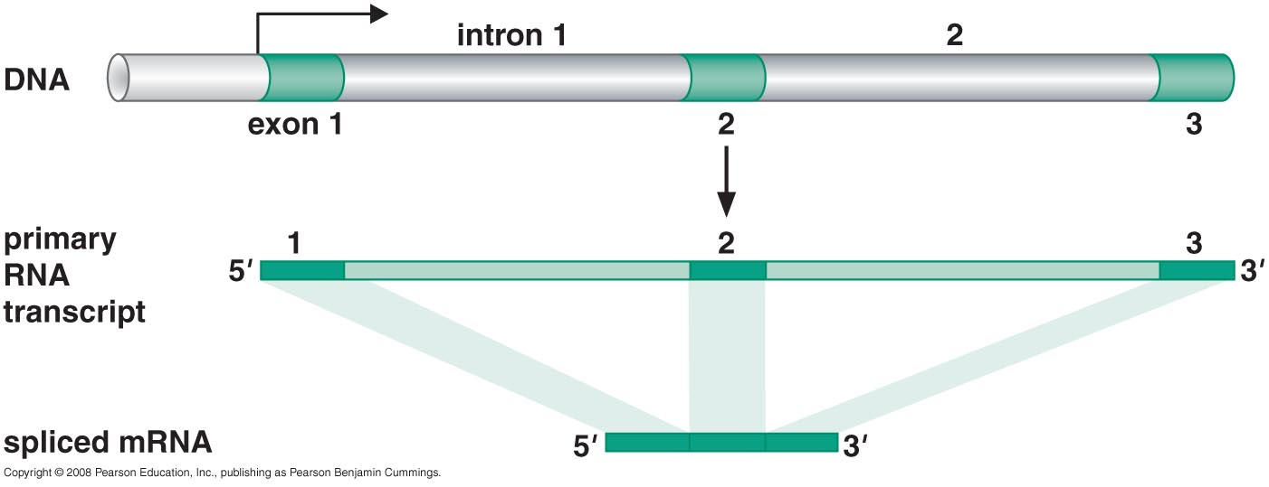
RNA splicing remove non-coding introns in a gene

Slide 11
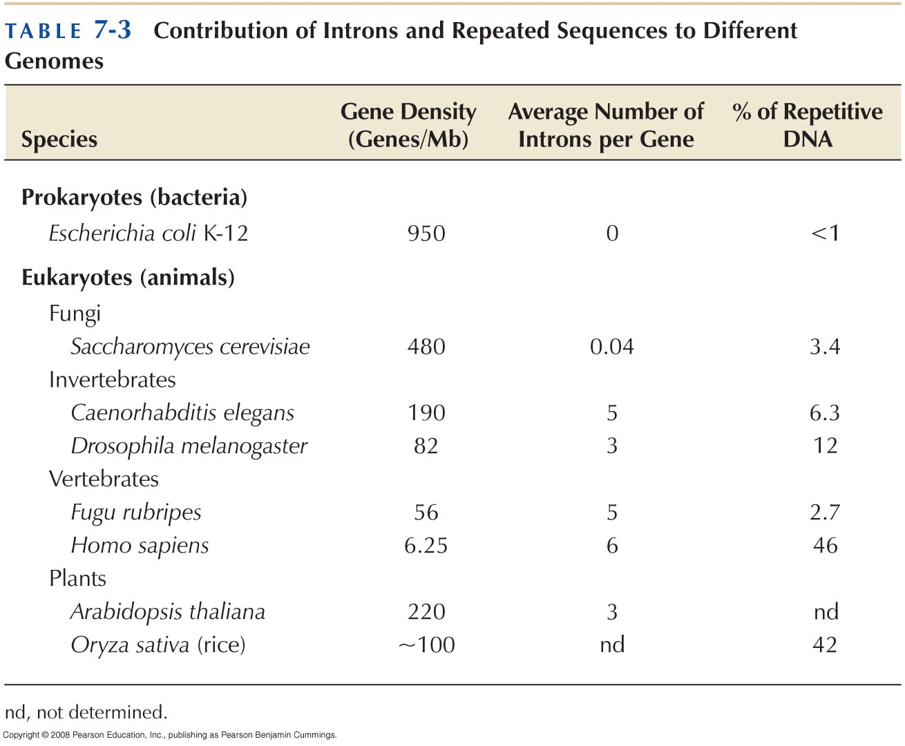

Slide 12
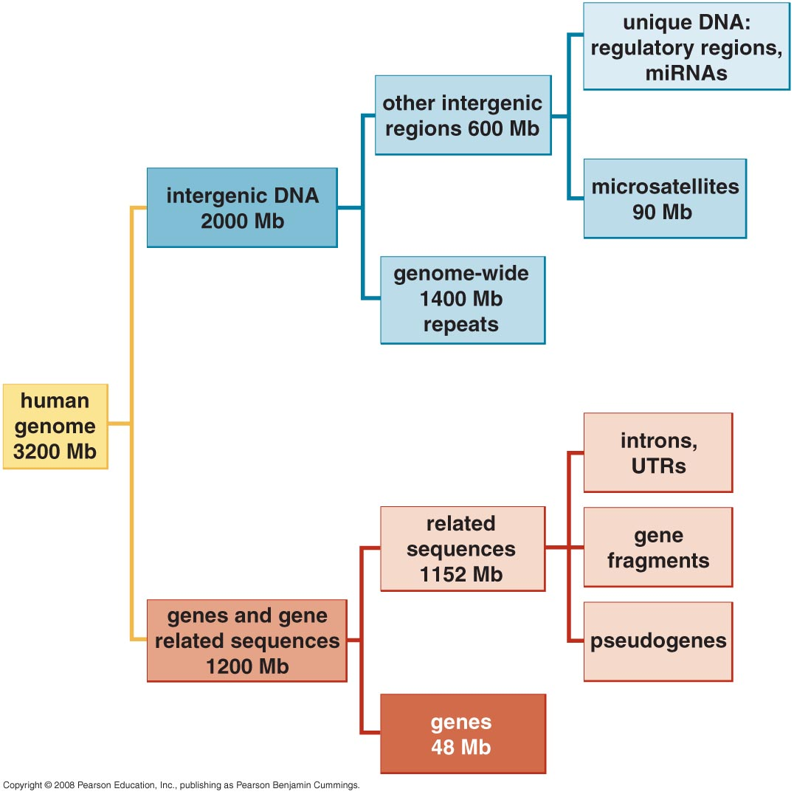
Organization and content of the human genome
Notes:
48/3200= 1.5%

Slide 13
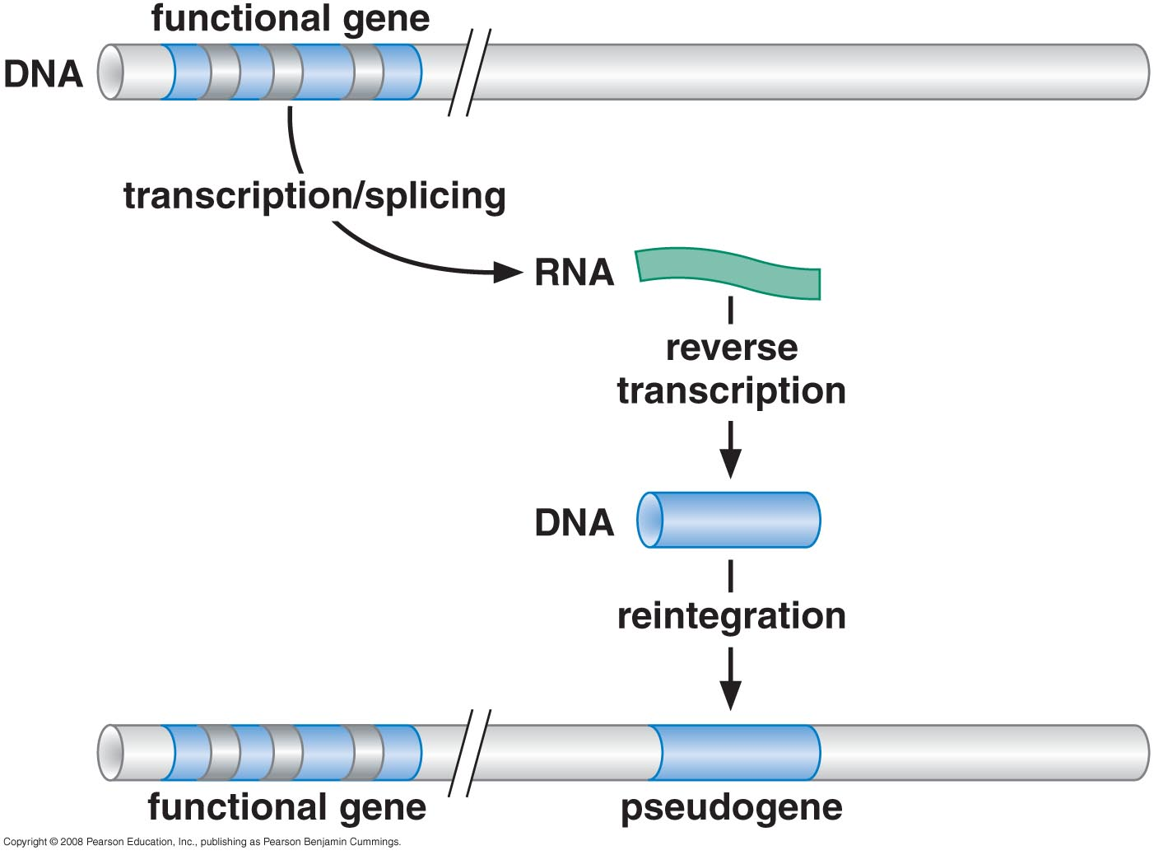
Pseudogenes arise from the actions of reverse transcription

Slide 14
The majority of human intergenetic sequences are composed of repetitive DNA
Microsatellite DNA (simple sequence repeats)
Genome-wide repeats (transposable elements)
LINES : (Long Interspersed Sequences)
Notes:
LINES: Long In

Slide 15
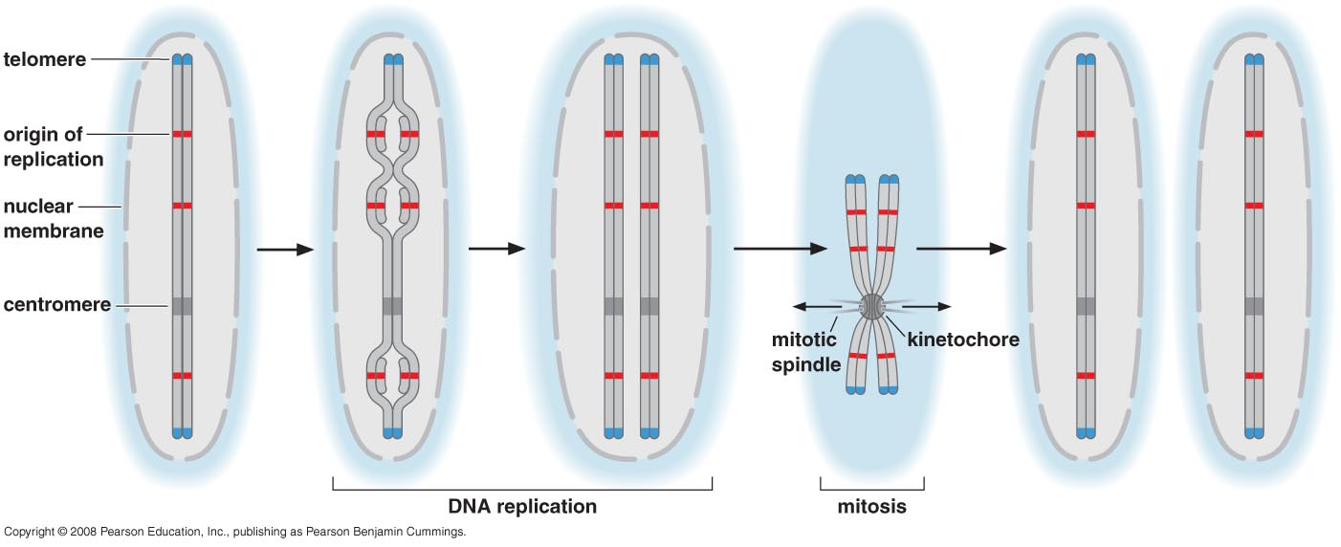
CHROMOSOME DUPLICATION AND SEGREGATION
Eukaryotic chromosomes require centromeres, telomeres, and origin of replication to be maintained during cell division

Slide 16
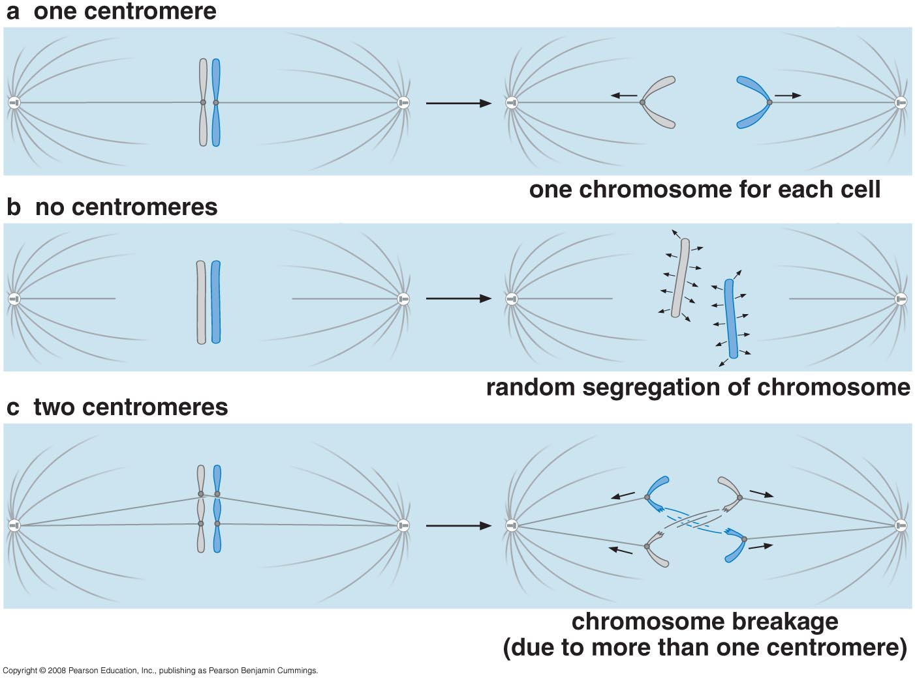
More or less than one centromere per chromosome is not good

Slide 17
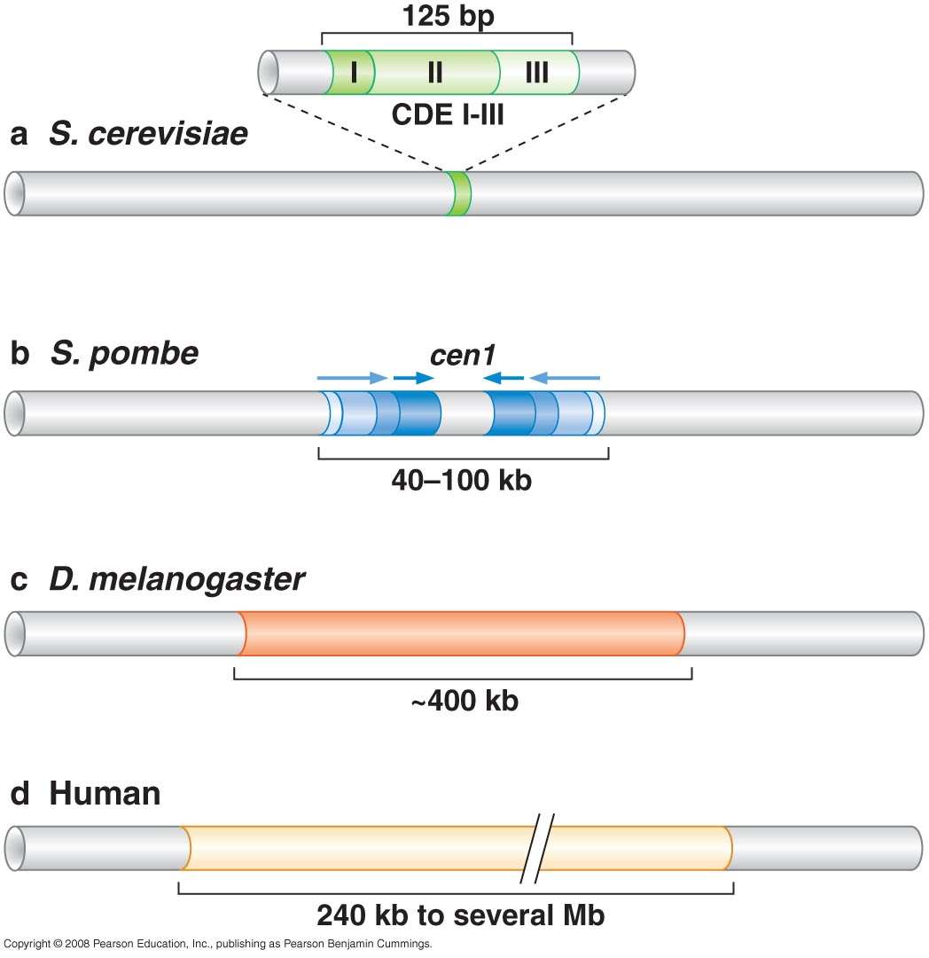
Centromere size and composition vary dramatically among different organisms

Slide 18
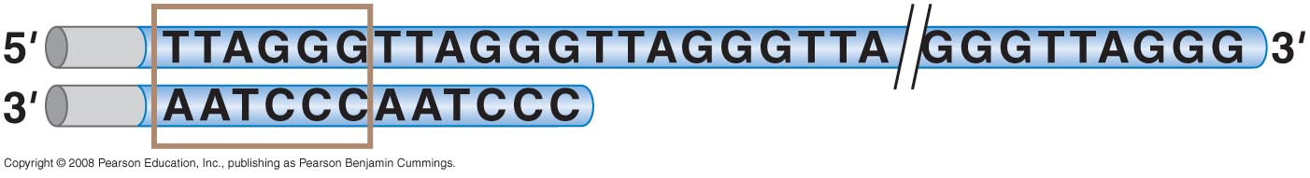
A typical telomere

Slide 19
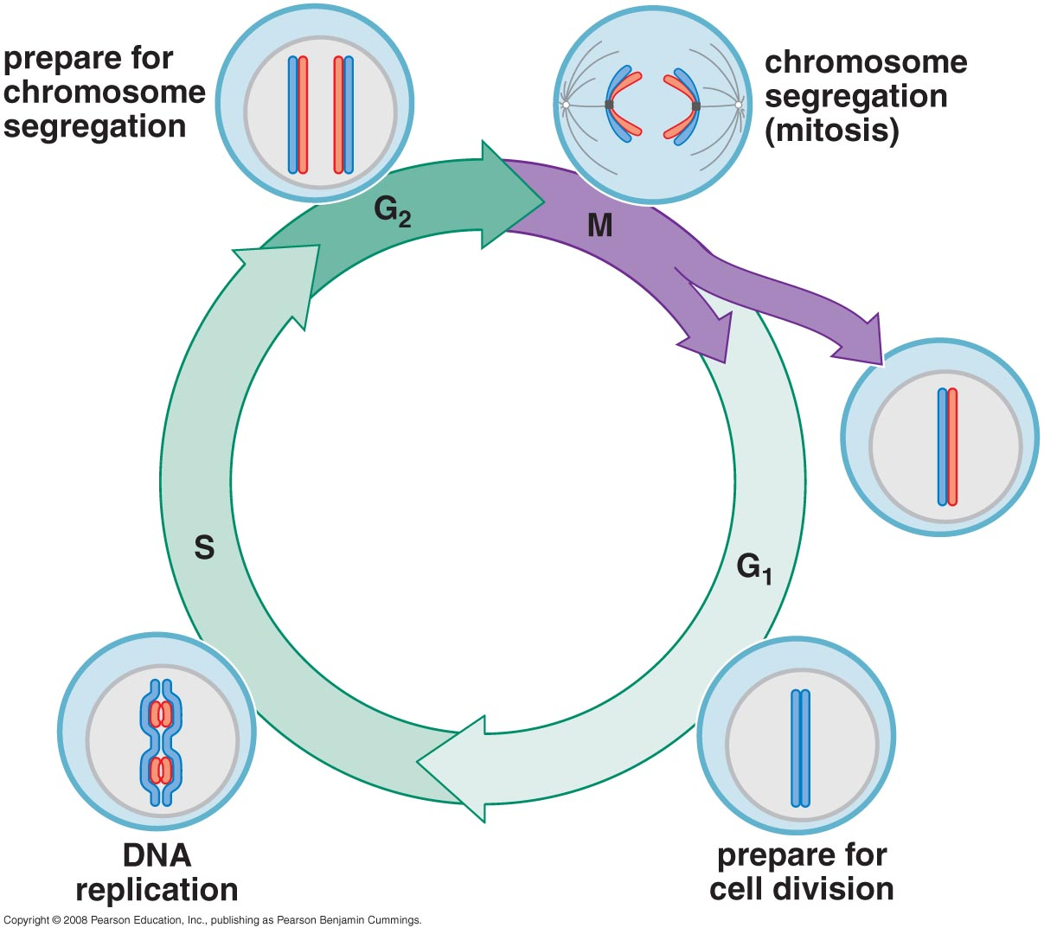
Eukaryotic chromosome duplication and segregation occur in separate phases of the cell cycle

Slide 20
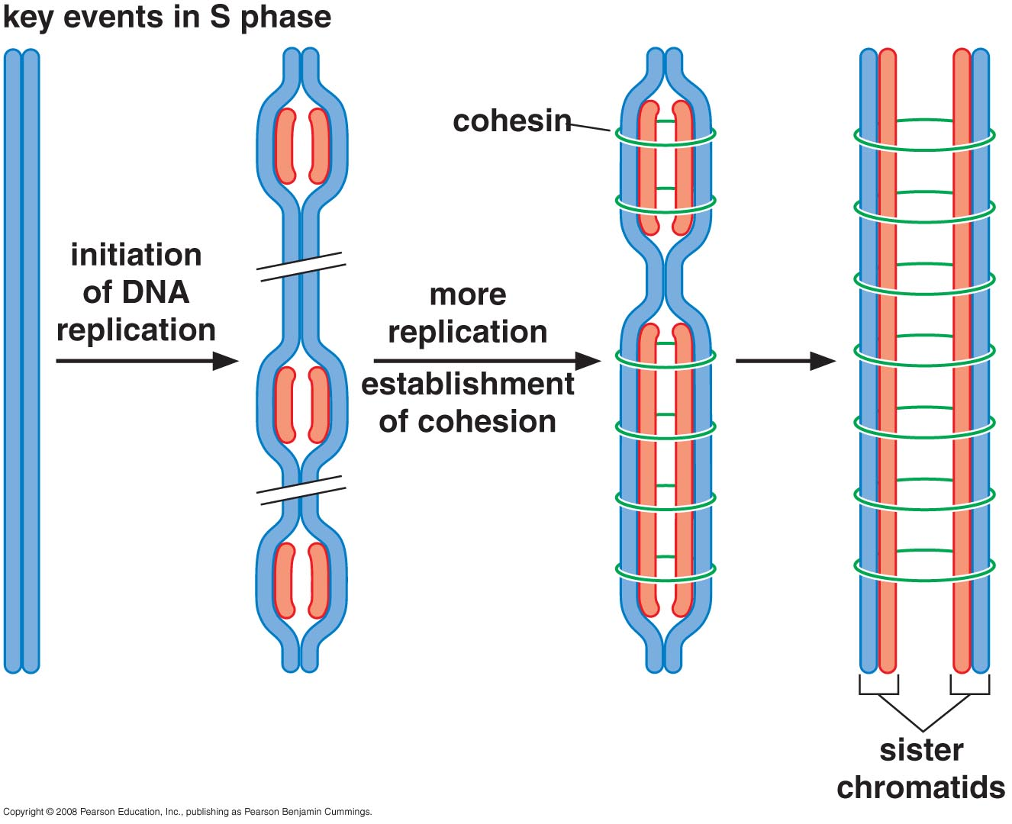

Slide 21
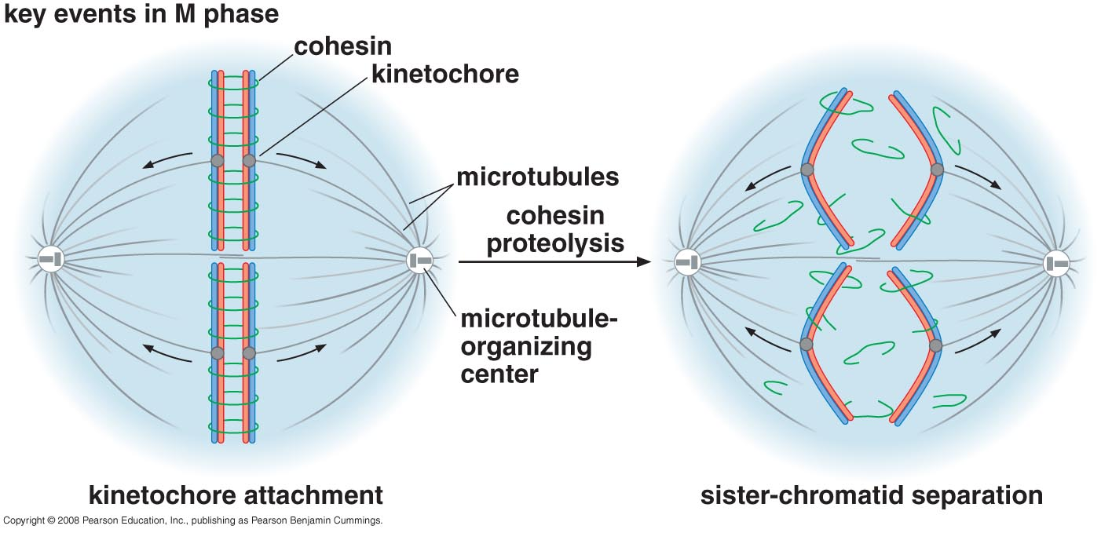

Slide 22
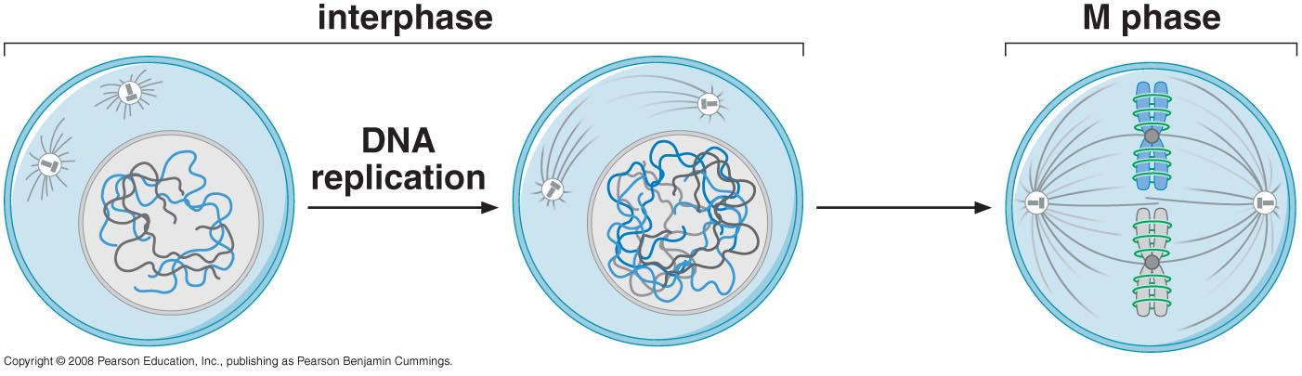
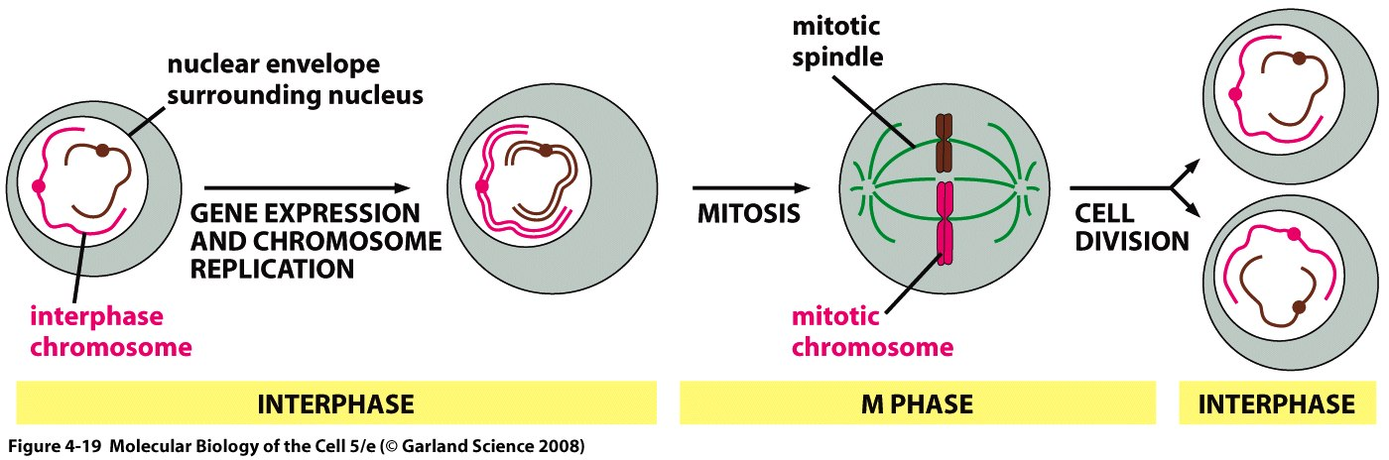
Chromosome structure changes as eukaryotic cells divide

Slide 23
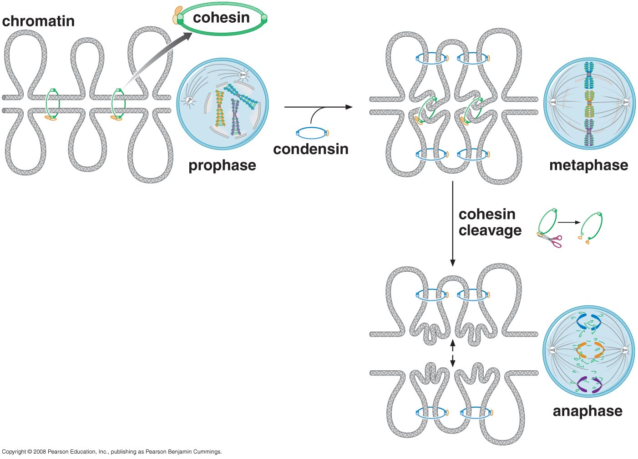
Sister-chromatid cohesion and chromosome condensation are mediated by SMC (structural maintenance of chromosome) proteins

Slide 24
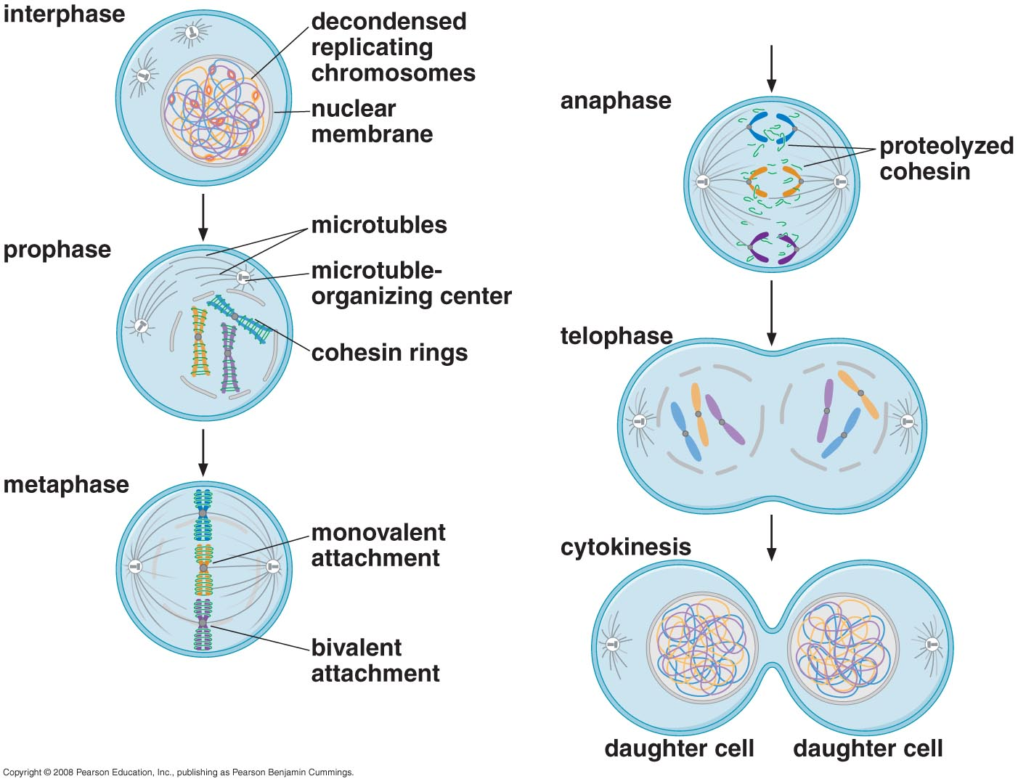
Mitosis maintains the parental chromosome number

Slide 25
During gap phases, cells prepare for the next cell cycle stage and check that the previous stage is completed correctly

Slide 26
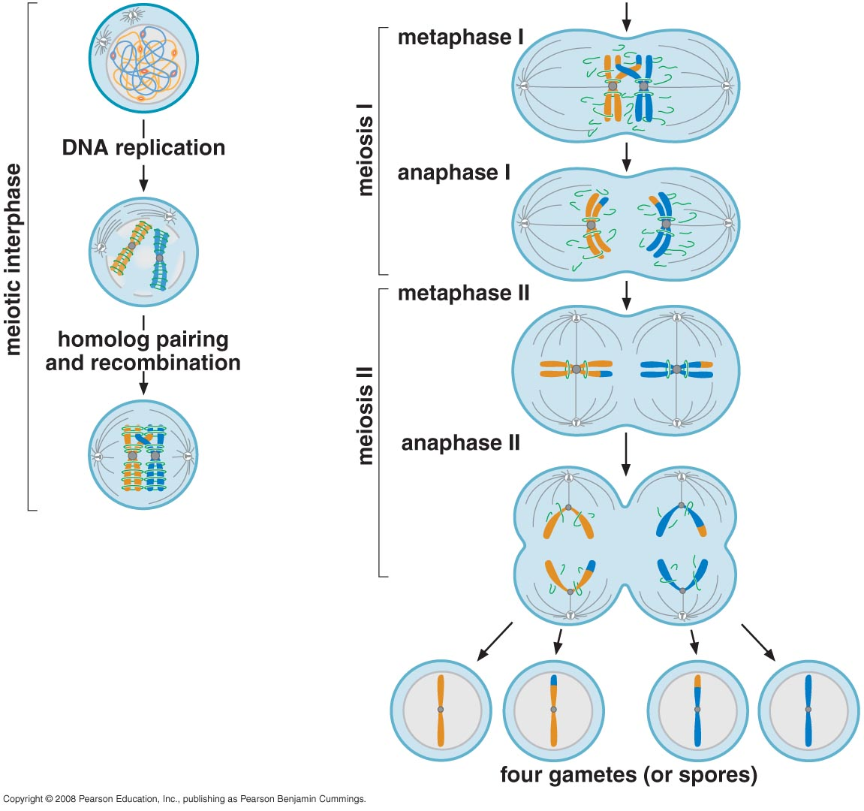
Meiosis reduces the parental chromosome number

Slide 27
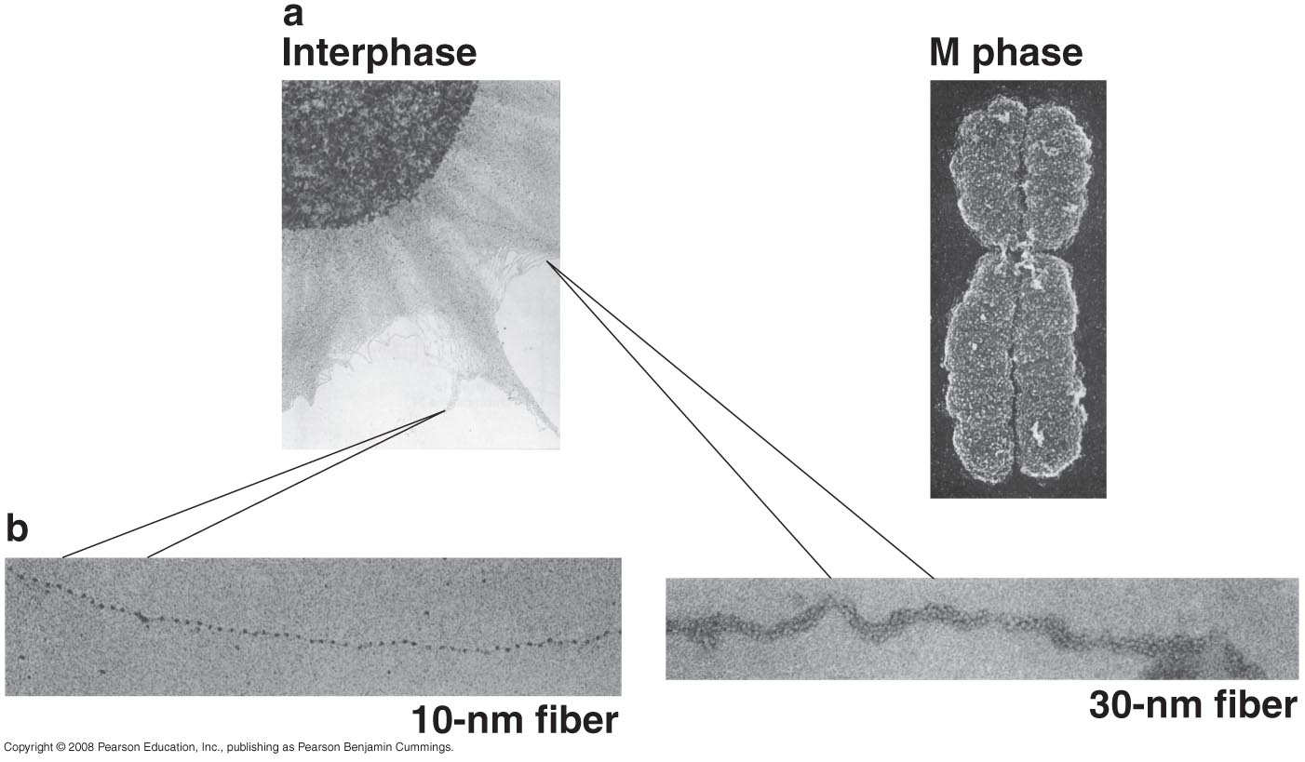
Different levels of chromosome structure can be observed by microscopy

Slide 28
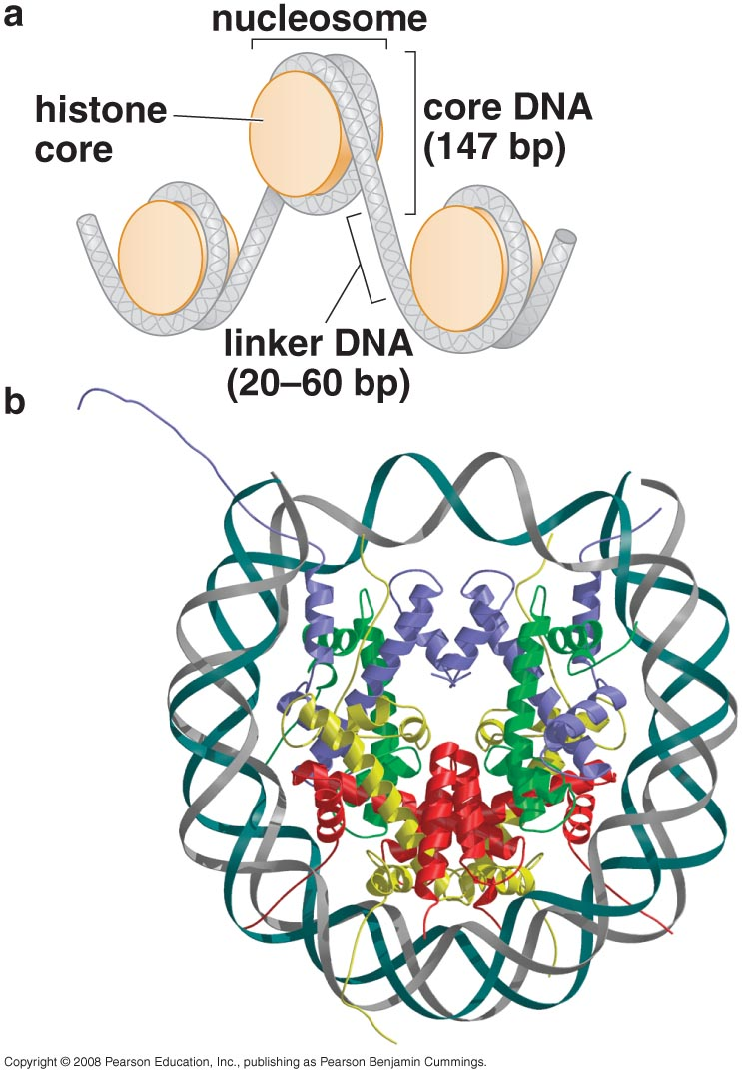
THE NUCLEOSOME
DNA Molecules Are Highly Condensed in Chromosomes
Nucleosomes Are the Basic Unit of Eukaryotic Chromosome Structure

Slide 29
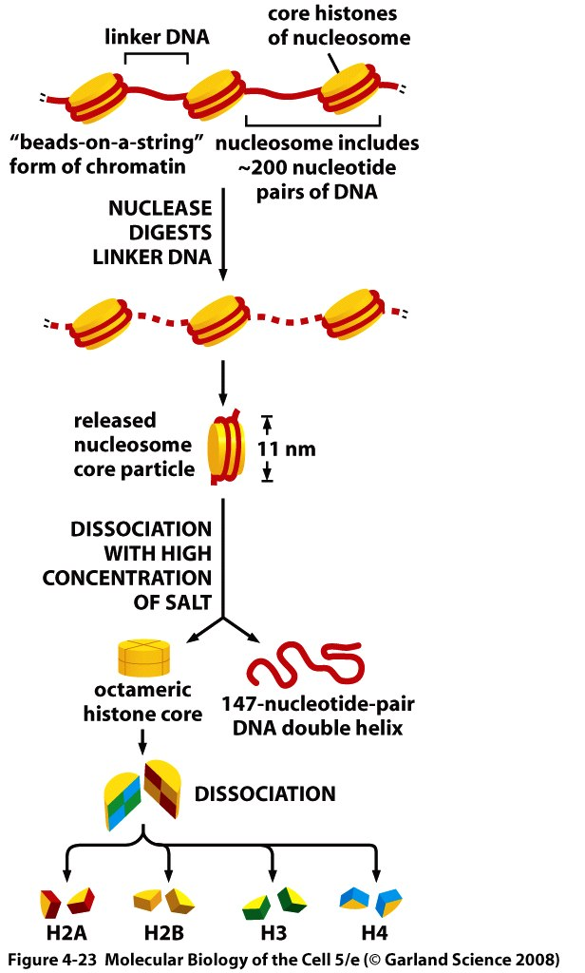
Structural organization of the nucleosome.
A nucleosome contains a protein core made of eight histone molecules. As indicated, the nucleosome core particle is released from chromatin by digestion of the linker DNA with a nuclease, an enzyme that breaks down DNA. (The nuclease can degrade the exposed linker DNA but cannot attack the DNA wound tightly around the nucleosome core.) After dissociation of the isolated nucleosome into its protein core and DNA, the length of the DNA that was wound around the core can be determined. This length of 146 nucleotide pairs is sufficient to wrap 1.65 times around the histone core.

Slide 30
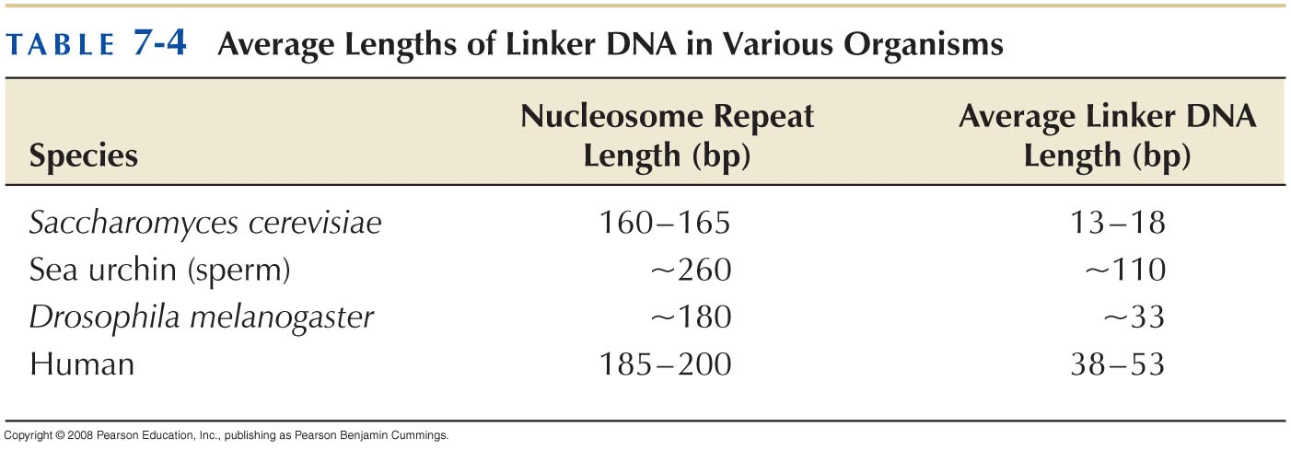

Slide 31
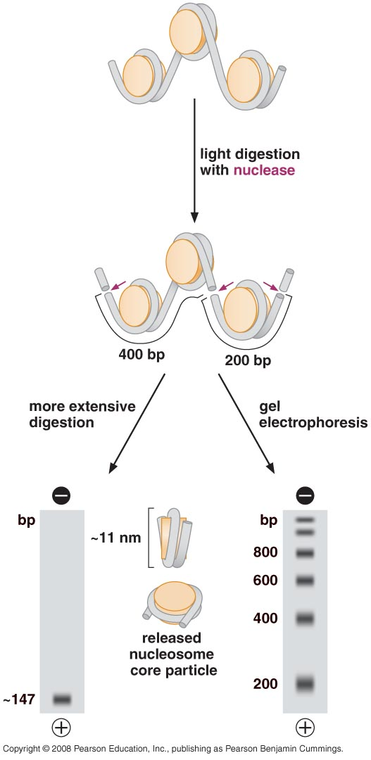
Micrococcal nuclease and the DNA associated with the nucleosome

Slide 32
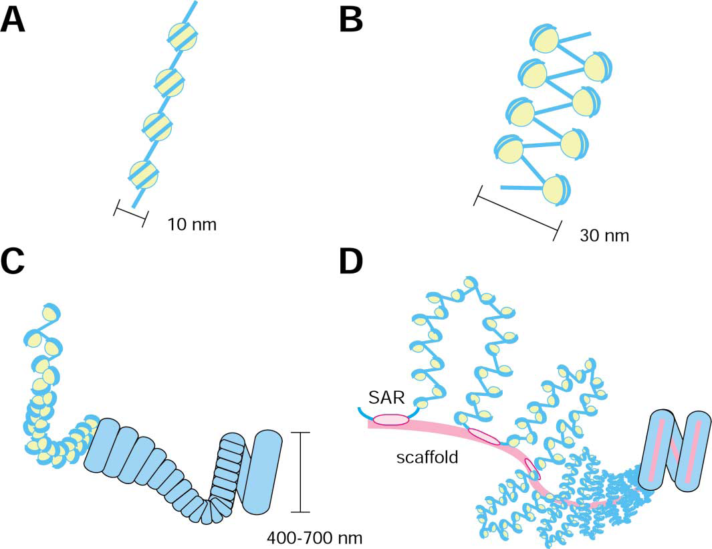
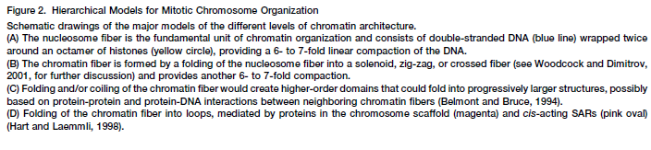

Slide 33
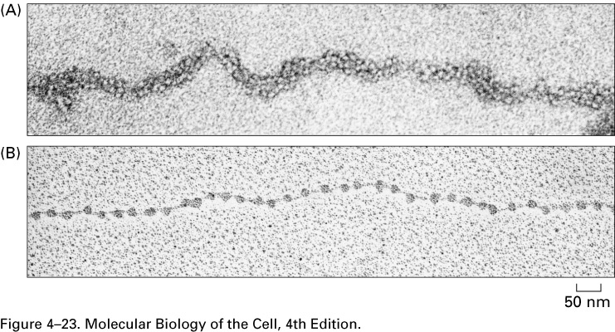
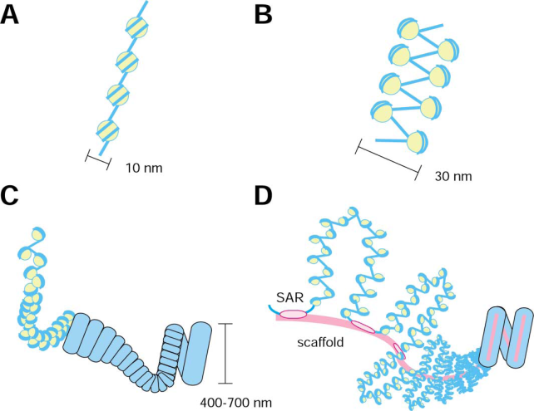
Nucleosomes as seen in the electron microscope.
(A) Chromatin isolated directly from an interphase nucleus appears in the electron microscope as a thread 30 nm thick. (B) This electron micrograph shows a length of chromatin that has been experimentally unpacked, or decondensed, after isolation to show the nucleosomes.

Slide 34
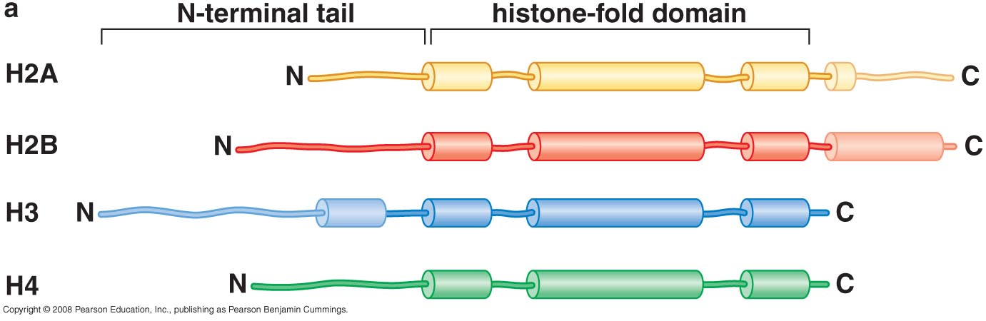
Histones are small, positive charged proteins
Core histones share a common structural fold

Slide 35
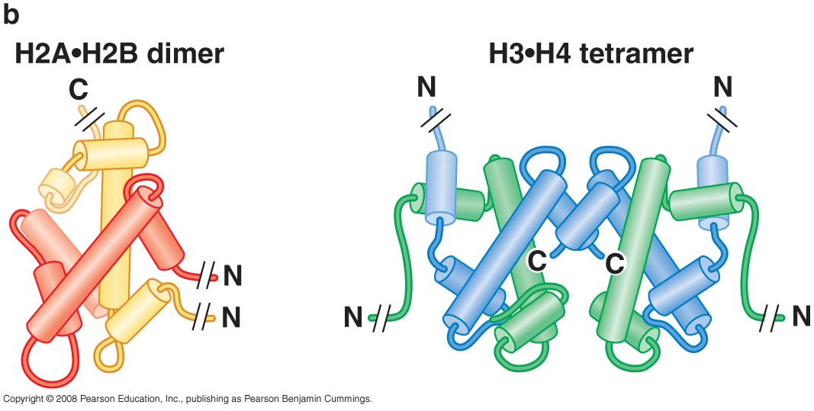

Slide 36
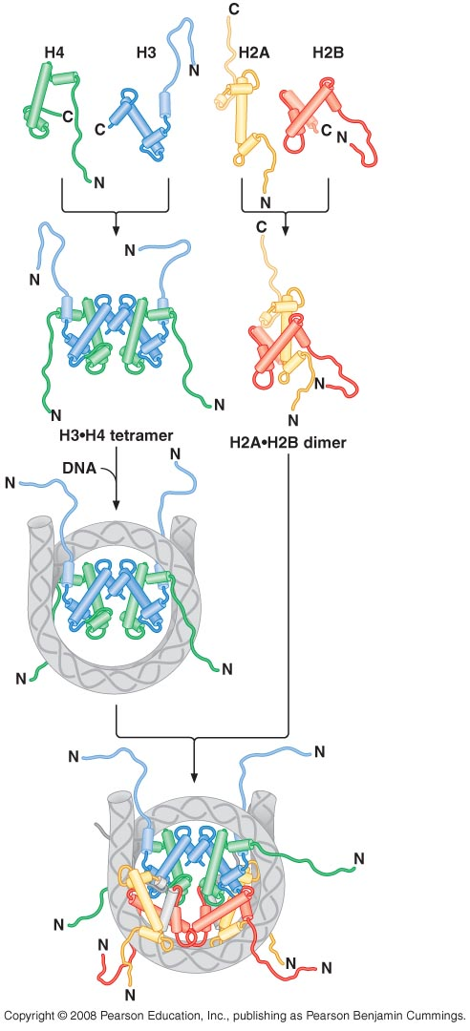
Assembly of a nucleosome

Slide 37
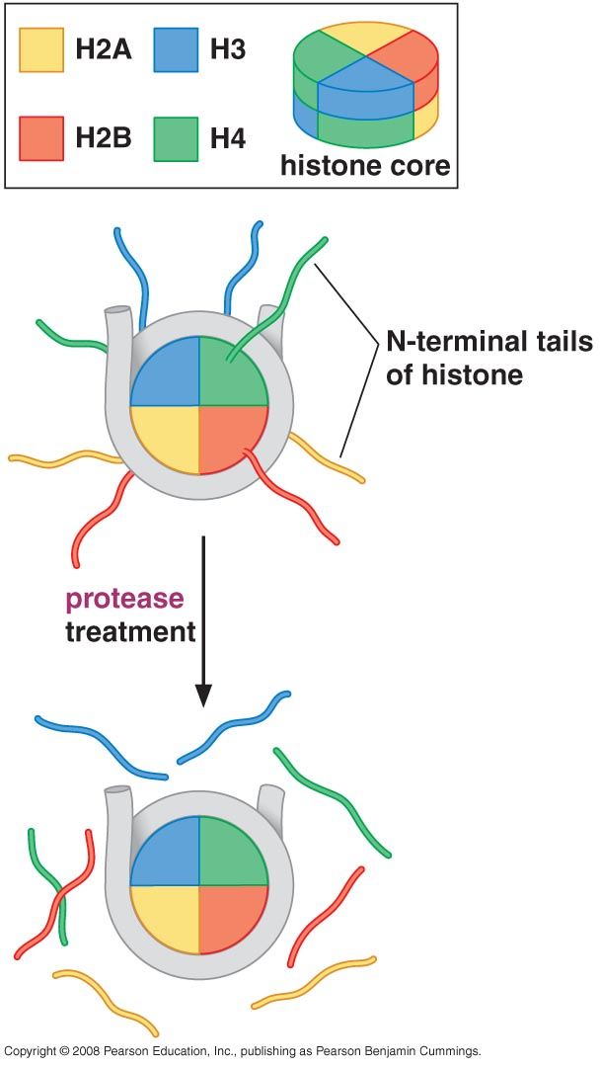
Amino-terminal tails of the core histones are accessible to proteases

Slide 38
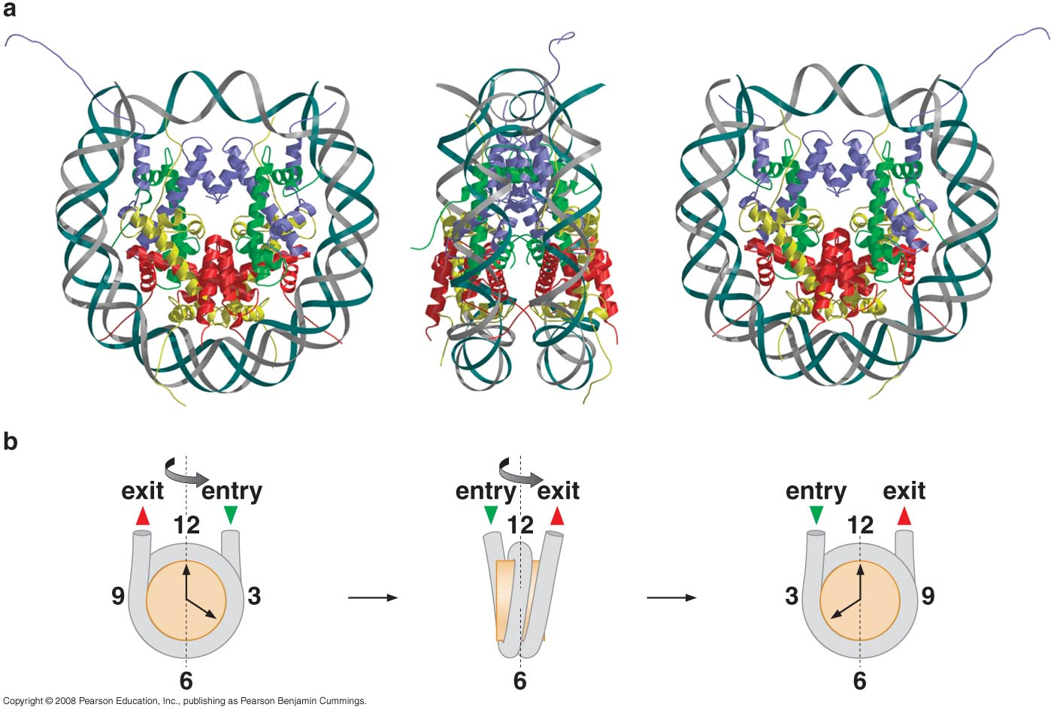
The atomic structure of the nucleosome
Histones bind characteristic regions of DNA within the nucleosome

Slide 39
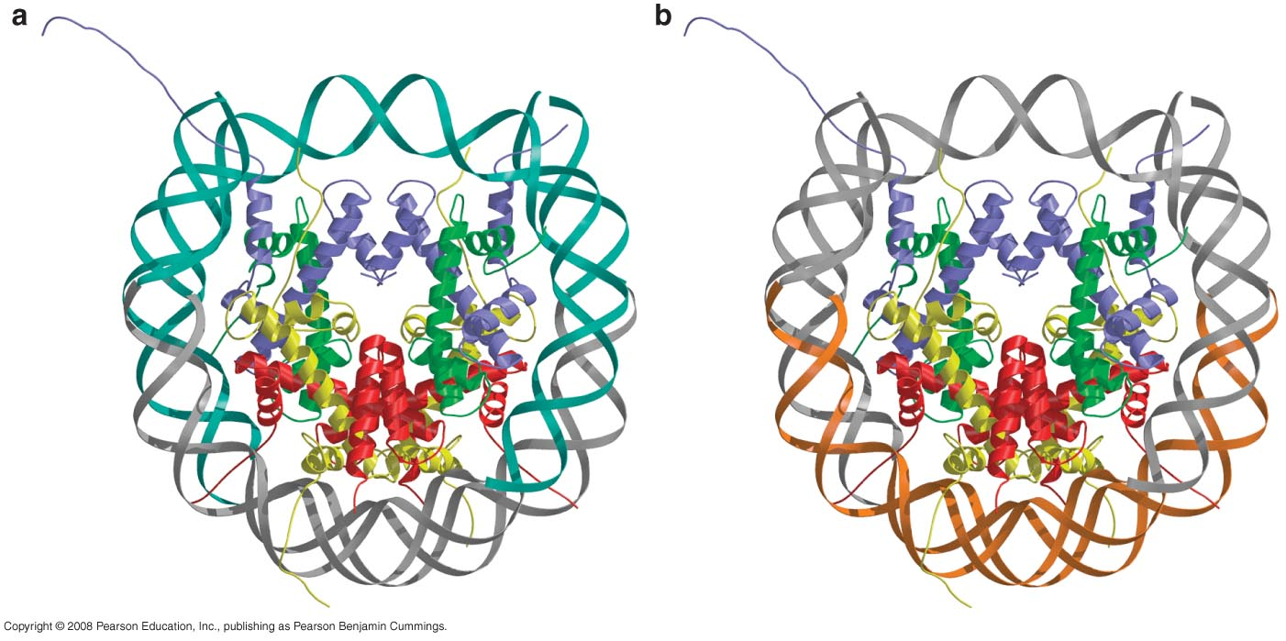
Interactions of the histones with nucleosomal DNA
H2A-H2B bind 30 bp of DNA on one side of nucleosome
H3-H4 bind the middle and the ends of DNA

Slide 40
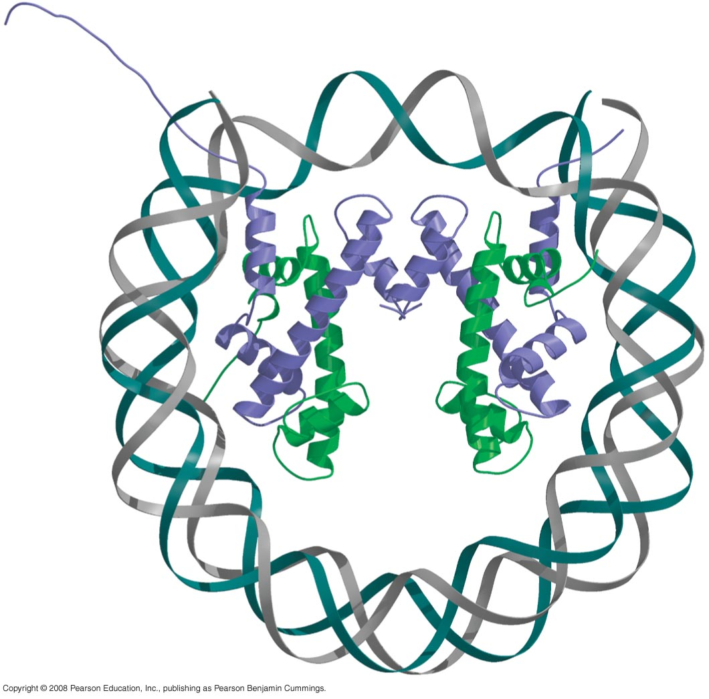
Nucleosome lacking H2A and H2B

Slide 41
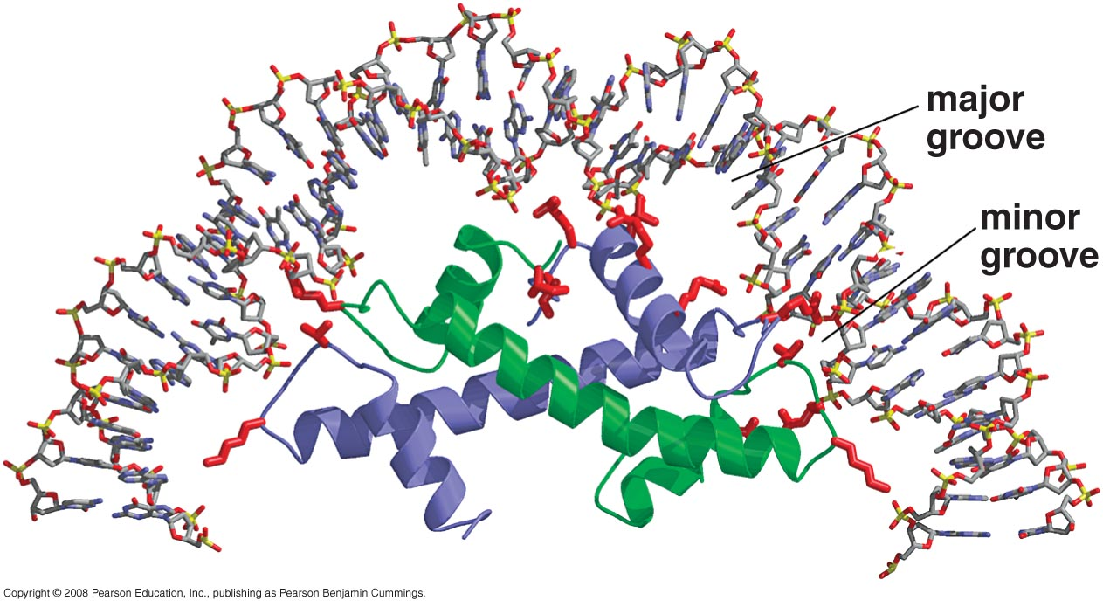
Many DNA sequence-independent contacts mediate the interaction between the core histones and DNA

Slide 42
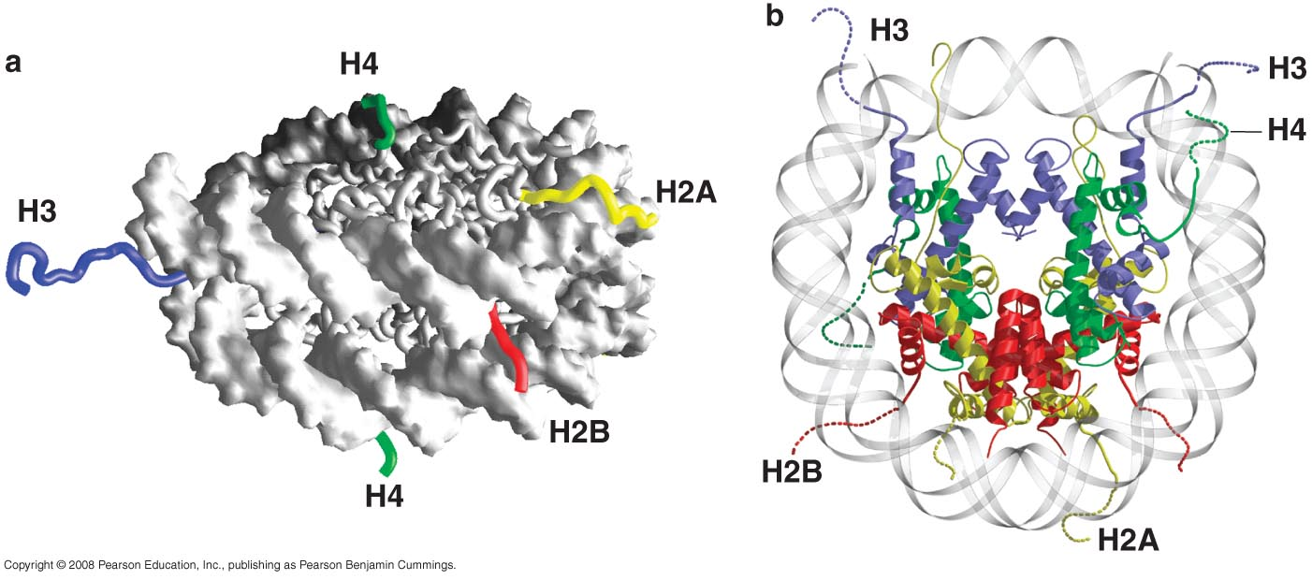
The histone –N-terminal tails stabilize DNA wrapping around the octamer

Slide 43
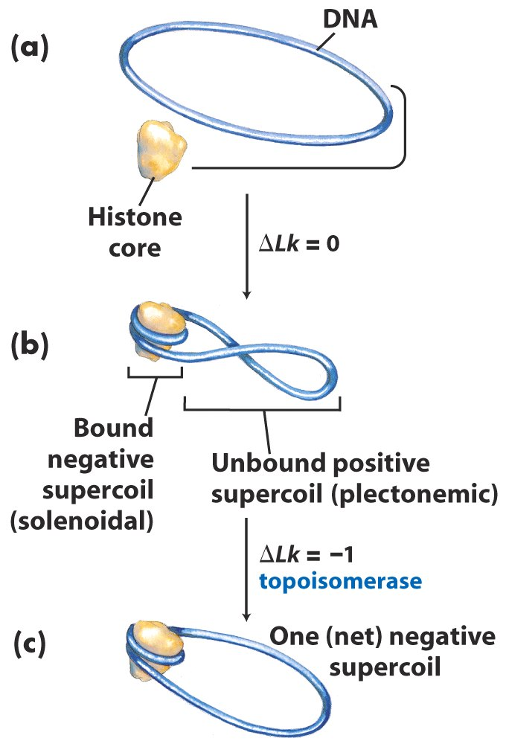
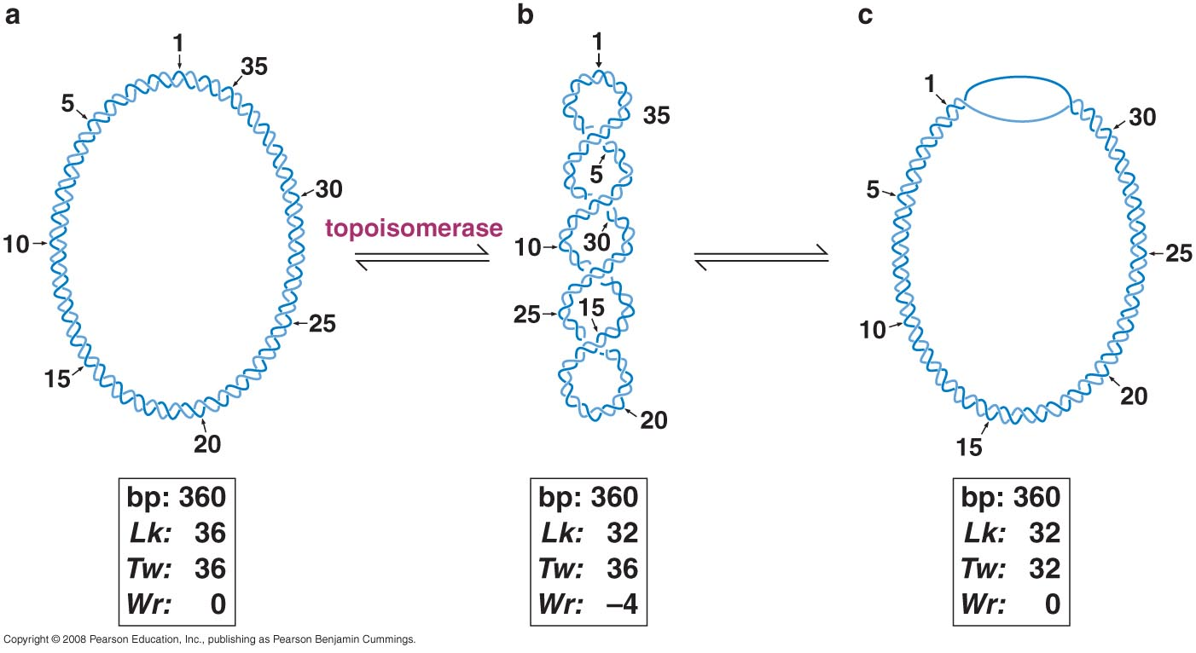
Wrapping of the DNA around the histone core store negative superhelicity
Removal of nucleosomes not only allows access to the DNA, but also facilitates DNA unwinding of nearby DNA Sequences

Slide 44
HIGHER-ORDER CHROMATIN STRUCTURE
Heterochromatin is highly organized and unusually resistant to gene expression
Heterochromatin: highly condensed higher-order structure forms that result in a barrier to gene expression
Euchromatin: the nucleosomes are found to be in much less organized assemblies

Slide 45
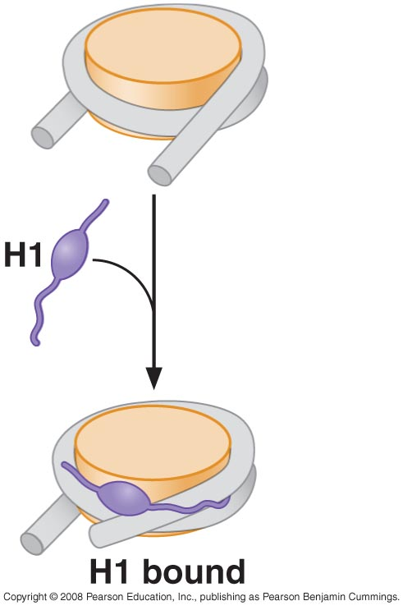
Histone H1 binds to the linker DNA between nucleosomes

Slide 46
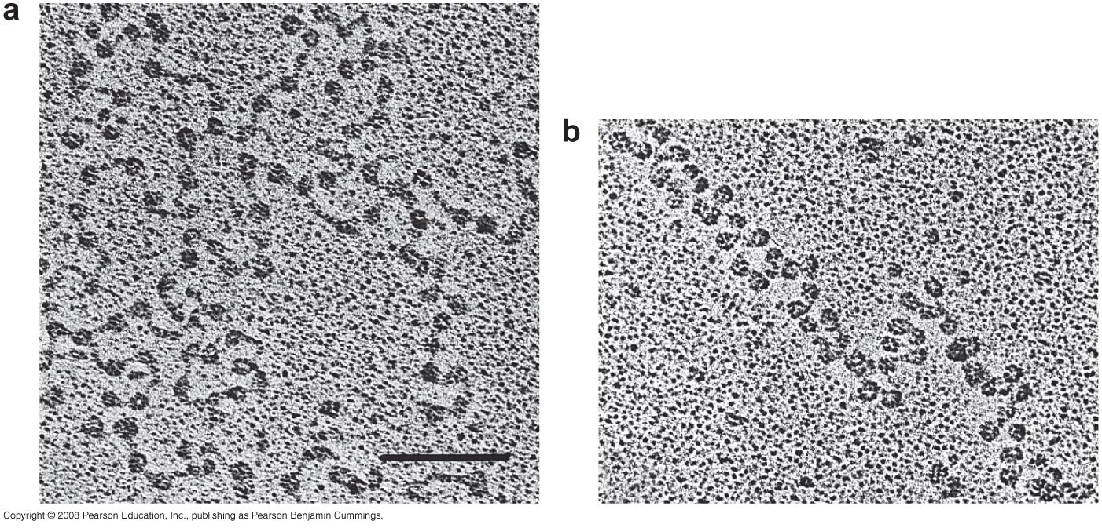
Addition of H1 leads to more compact nucleosomal DNA

Slide 47
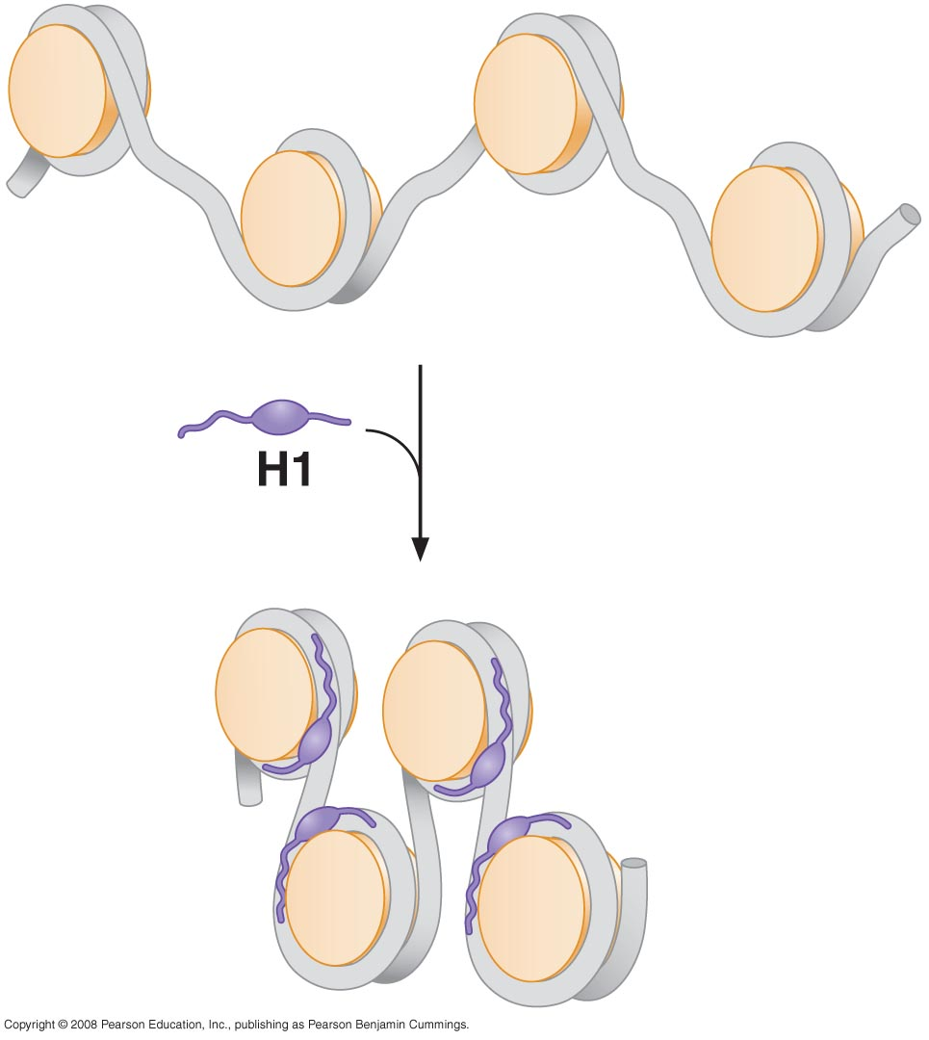

Slide 48
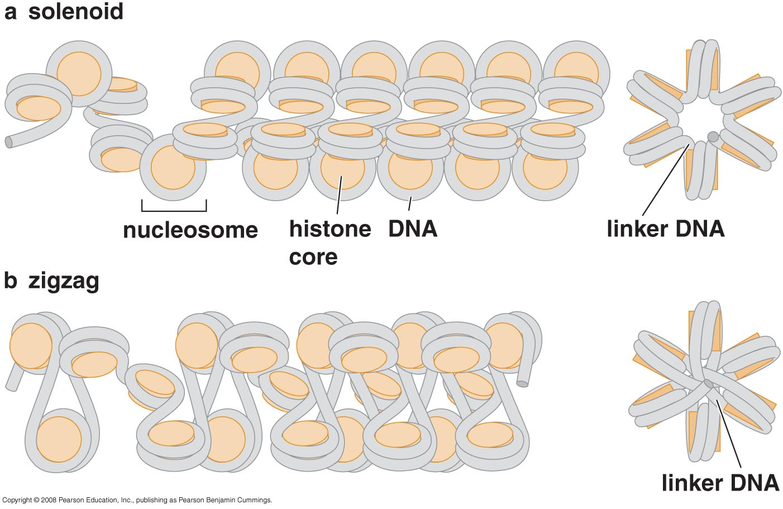
Nucleosome arrays can form more complex structures; the 30-nm fiber

Slide 49
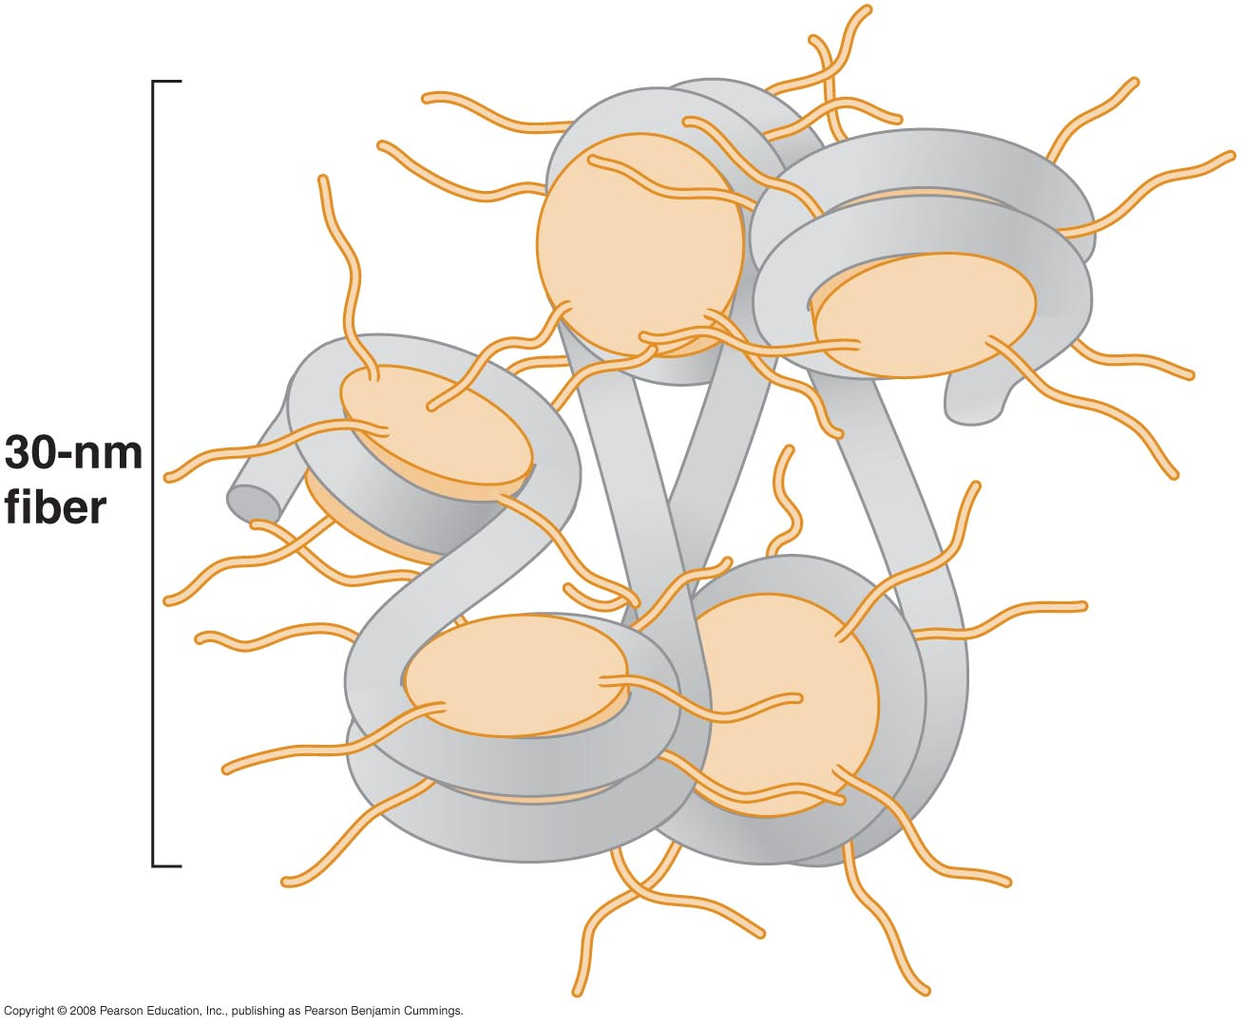
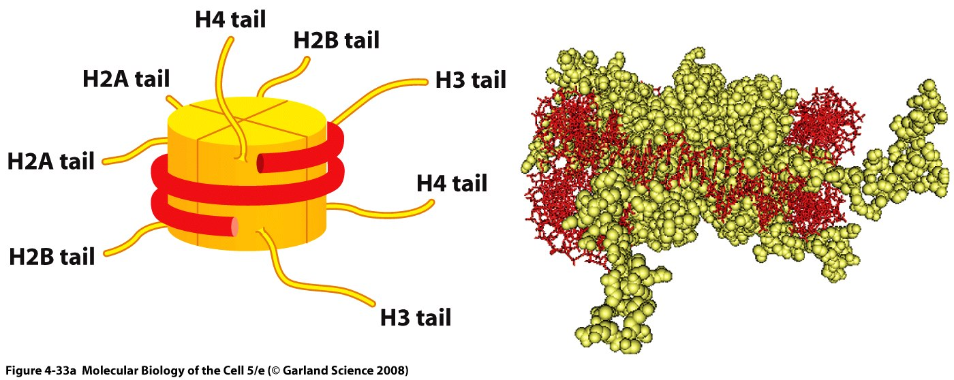
The histone tails are required for the formation of the 30- nm fiber. (Left): The approximate exit points of the eight histone tails, four from each histone subunit, that extend from each nucleosome. In the high-resolution structure of the nucleosome the tails are largely unstructured, suggesting that they are highly flexible. (Right): A speculative model showing how the histone tails may help to pack nucleosomes together into the 30-nm fiber. This model is based on (1) experimental evidence that histone tails aid in the formation of the 30-nm fiber, (2) the x- ray crystal structure of the nucleosome, which showed that the tails of one nucleosome contact the histone core of an adjacent nucleosome in the crystal lattice, and (3) evidence that the histone tails interact with DNA.

Slide 50

Further compaction of DNA involves large loops of nucleosomal DNA

Slide 51


Slide 52


Chromatin packing

Slide 53

Histone variants alter nucleosome function
Chromatin acquires additional variety through the site-specific insertion of a small set of histone variants

Slide 54


Slide 55

The Chromatin in centromeres reveals how histone variants can create special structures
CENP-A

Slide 56

REGULATION OF CHROMATIN STRUCTURE
Interaction of DNA with the histone core is dynamic

Slide 58

Nucleosome-remodeling complexes facilitate nucleosome movement

Slide 59

Nucleosomal DNA sliding catalyzed by nucleosome –remodeling complexes

Slide 60


Slide 61

Some nucleosomes are found in specific positions: nucleosome positioning
DNA-binding protein-dependent nucleosome positioning

Slide 62

Particular DNA sequences have a high affinity for the nucleosome

Slide 64

Modification of the N-terminal tails of the histones alters chromatin accessibility

Slide 65


Slide 66

The covalent modifications and the histone variants act in concert to produce a “histone code” that help to determine biological function
Protein domains in nucleosome-remodeling and –modifying complexes recognize modified histones

Slide 67

Specific enzymes are responsible for histone modification

Slide 68

Nucleosome modification and remodeling work together to increase DNA accessibility

Slide 69

NUCLEOSOME ASSEMBLY
Nucleosomes are assembled immediately after DNA replication

Slide 70

Chromatin structures can be directly inherited

Slide 71

Inheritance of parental H3-H4 tetramers facilitates the inheritance of chromatin states

Slide 72

Chromatin structures add unique features to eukaryotic chromosome function
How the packaging of DNA in chromatin can be inherited during chromosome replication

Slide 73

Assembly of nucleosomes requires histone ”Chaperones”

Slide 74


